Slide 1
CLOUD COMPUTING SECURITY ENHANCEMENT BY EFFICIENT ENCRYPTION SCHEME
PRESENTED BY:
DEBANJAN DEB RA1511003010534
AVIRAL VERMA RA1511003010688
Under the guidance of –
Ms. J.V. Vidhya

Slide 2
ABSTRACT
Cloud Computing is a technology that has seen a spurious growth recently and is being deployed for personal as well as business purposes. Cloud computing is defined as the delivery of computing services – namely servers, storage, databases, networking, software, analytics and intelligence over the Internet to offer faster innovation, flexible resources and economies of scale. With the feature becoming increasingly integral to various services provided across the inter-connected digital world, it is imperative that its susceptibility be assessed and security made impenetrable to protect the sensitive information Cloud servers store. Cloud security has been vulnerable to threats and in several cases has led to Data Loss, Information Hacking and Denial of Services. These incidents have given rise to widespread concern regarding the data security that these Cloud Services employ. However, security models and security tools are being continually enhanced. This project aims to define the term “Cloud Computing”, its functionality and implementation, define the utility and essentiality of Cloud Security and refer to its existence.

Slide 3
INTRODUCTION
Cloud computing security or, more simply, cloud security refers to a broad set of policies, technologies, and controls deployed to protect data, applications, and the associated infrastructure of cloud computing. It is a sub-domain of computer security, network security, and, more broadly, information security.
The cloud services are offered majorly in the form of the following three models:
Software as a Service (SaaS)
Platform as a Service (PaaS)
Infrastructure as a Service (IaaS)

Slide 4
INTRODUCTION
As per the current system, cloud security is still an area of concern. With cloud computing, organizations can use services and data is stored at any physical location outside their own control. This facility raised the various security questions like privacy, confidentiality, integrity and demanded a trusted computing environment wherein data confidentiality can be maintained. To induce trust in the computing, there is need of a system which performs authentication, verification and encrypted data transfer, hence maintaining data confidentiality. Here in our project we are trying to point out some measures, which will make it more safe and secure.

Slide 5
IMPORTANT TERMS
Cloud Computing:
Cloud computing is defined as the delivery of computing services – namely servers, storage, databases, networking, software, analytics and intelligence over the Internet to offer faster innovation, flexible resources and economies of scale.

Slide 6
IMPORTANT TERMS
Network Security
Network security consists of the policies and practices adopted to prevent and monitor unauthorized access, misuse, modification, or denial of a computer network and network-accessible resources. It involves the authorization of access to data in a network, which is controlled by the network administrator.

Slide 7
IMPORTANT TERMS
Information Security
Information Security is the practice of preventing unauthorized access, use, disclosure, disruption, modification, inspection, recording or destruction of information. The information or data may take any form, e.g. electronic or physical.

Slide 8
IMPORTANT TERMS
Cloud Security
Cloud computing security or, more simply, cloud security refers to a broad set of policies, technologies, and controls deployed to protect data, applications, and the associated infrastructure of cloud computing.

Slide 9
IMPORTANT TERMS
Encryption & Decryption
Encryption is the process of translating plain text data (plain text) into something that appears to be random and meaningless (cipher text). It allows for secure exchange of data.
Decryption is the reverse process Encryption, i.e. converting cipher text back to plaintext.

Slide 10
IMPORTANT TERMS
Key Exchange
Key Exchange is defined as any method in cryptography by which cryptographic keys are exchanged between two parties, namely sender and receiver to exchange sensitive information allowing the use of a cryptographic algorithm.

Slide 11
IMPORTANT TERMS
AES-256 Encryption Standard
The Advanced Encryption Standard, or AES-256, is a symmetric block cipher deployed to protect classified information and is implemented in software and hardware throughout the world to encrypt sensitive data.

Slide 12
IMPORTANT TERMS
Diffie – Hellman Key Exchange Protocol
Diffie–Hellman key exchange (DH) is a method of securely exchanging cryptographic keys over a public channel. It is a way of sharing a secret key to establish trust between sender and receiver that precedes exchange of sensitive information.

Slide 13
INNOVATION IDEA
The idea that motivates this project is the collaboration of cryptography with cloud computing to ensure an efficient security mechanism that successfully protects data storage as well as authenticates data access.
At its core, Cloud Services are nothing but widely inter-connected network of configurable system resources.

Slide 14
INNOVATION IDEA
Cryptography is equipped with various protocols, in our focus namely the Diffie-Hellman Key Exchange and Advanced Encryption Standard (AES-256) that are utilised for secure data transfer over a network.
The idea is to implement this feature of cryptography on cloud servers so as to resolve the concerns over Cloud Security.

Slide 15
PURPOSE
The security of data stored in clouds is of a major concern today. This security mechanism is comprised primarily of two parts :-
Server-side Security
Client-side Security
The purpose of this project is to redefine the Client-side security so as to give more control to the most at-risk party of Cloud Computing, i.e. the Cloud Consumer.

Slide 16
PURPOSE
The client stores sensitive information on the cloud servers but in truth has limited control of privacy, authenticity and verifiability of the data.
There is an imminent need to ensure security of data at the client-side.
The project aims to take the control of security of data from the hands of the server and give it in the hands of the clients.

Slide 17
PRESENT SYSTEM & limitations
Fully Homomorphic Encryption
The C.Gentry presented encryption method for preserving the privacy of data. This method of encryption enables the computation on the encrypted data which is stored in cloud. Cloud provider is not aware of data processing function as well as result of computation. It is a powerful tool for privacy maintenance but it fails to use practically.

Slide 18
PRESENT SYSTEM & limitations
Security Using Elliptic Curve Cryptography
The V.Gampala and et al. proposed the data security using the elliptic curve cryptography. This type of encryption algorithm helps to preserve the confidentiality along with authentication between cloud and the user but fails to preserve all the security issues majorly the access authentication.

Slide 19
PROPOSED SYSTEM
The proposed work will ensure the security of the data at the client-end. The proposed implemented application will ensure the above mentioned level of security by applying cryptographic technique of encrypting the data before uploading to the cloud. In this proposed mechanism to ensure safety of data at the client-end, three participants are involved. These three participants are End User (EU), Third Party Auditor (TPA) and Cloud Service Provider (CSP).

Slide 20
PROPOSED SYSTEM
Participant | Function
End User (EU) | EU is the client who accesses and enjoys the services provided by the Cloud Service Provider.
Third Party Auditor (TPA) | TPA ensures the authenticity of the entities over the network. It ensures secure means of sharing the key between two users.
Cloud Service Provider (CSP) | CSP is the entity who is responsible for providing the cloud services to the end users

Slide 21
Proposed system
The Proposed System works as described by the following steps :-
A) Key Generation : EU uses Diffie-Hellman algorithm to generate the shared key. This key is used to encrypt the file before uploading this data to the cloud storage.

Slide 22
Proposed system
B) Key Sharing : The shared key that is being generated with the help of Diffie-Hellman algorithm via the Key Generation operation needs to be sent over the network to another user who wishes to access the data. This is because the data that is stored in the cloud is in the encrypted format and when it is retrieved from the cloud, it needs to be decrypted. To decrypt the file, the shared key is required at this end. The key generated using Diffie-Hellman algorithm between the EUs by using the secure channel.

Slide 23
Proposed system
C) Encryption : In the first step, the author who generated the data, encrypted the data using the shared key that was generated through the KeyGen() process using the Diffie-Hellman algorithm. The URL and the file are encrypted with the help of AES-256 Algorithm. It is then broken into chunks and distributed so that even if a chunk is cracked by an unauthorized entity, the file is still safeguarded. The file, thus encrypted, is uploaded to the cloud storage.

Slide 24
Proposed system
D) Decryption : The file to be retrieved is first compiled from its various distributed chunks. Once the file is retrieved from the cloud, to read the contents of the file and to retrieve the URL, thus received by the EU2 from EU1, it needs to be decrypted as it was stored in the cloud in an encrypted format and the URL was encrypted before sharing it with EU2, respectively. To decrypt this retrieved file and the URL, the end user EU2 needs the shared key generated through the Key Generation process generated by the owner of the file with the help of Diffie-Hellman algorithm. This shared key is received by the recipient of the file via a secure channel.

Slide 25
Proposed system
E) URL Generation : Using the Amazon Web Services, the URL can be generated by using the Generate Web URL option. When the owner of the data wishes to share the file with another user, he will share the URL with that user. This URL is encrypted before transmission to another user to ensure that even if it is attacked during transmission, it will be safeguarded against it.

Slide 26
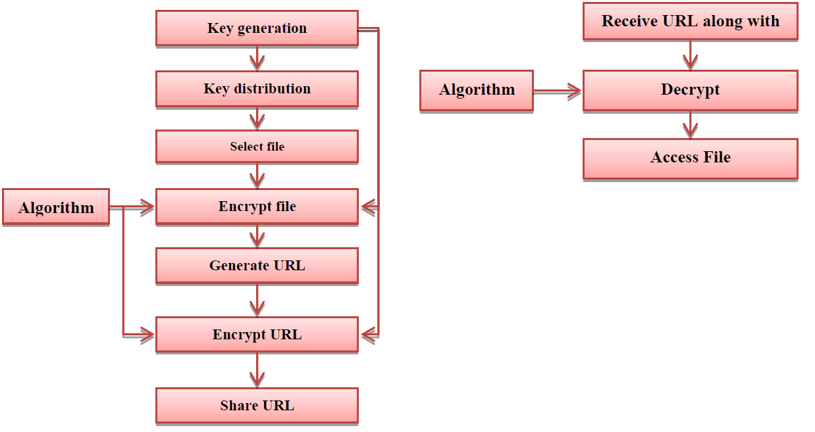
PROPOSED SYSTEM

Slide 27
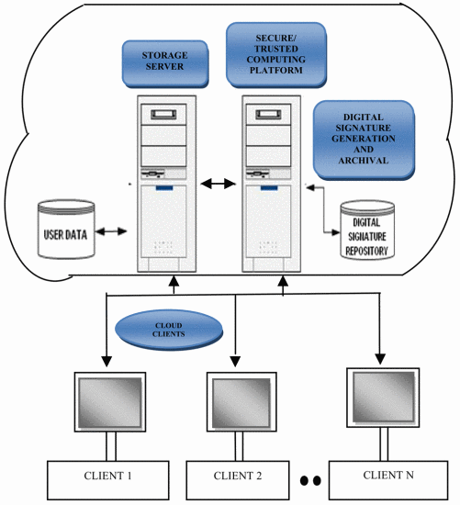
PROPOSED SYSTEM

Slide 28
Encrypt & Upload
End User uses AES-256 encryption to encrypt the file. It is decomposed and uploaded in multiple chunks.
EU 1
Cloud Storage

Slide 29
Encrypt URL at Sender’s End
EU1 retrieves URL from CSP and encrypts it using a DH key. This encrypted URL is then shared with EU2.
EU 1
Step 1: Retrieve URL
Cloud Storage
Step 2: Encrypt URL
EU 2
Step 3: Share URL

Slide 30
Share & Decrypt URL at Receiver's End
EU2 receives the encrypted URL with key and uses it to decrypt it. It is then used to retrieve the URL with compiled file from the CSP.
Step 1: Receive Encrypted URL from EU1
Step 2: Receive Shared Key from EU1
EU 2
Cloud Storage
Step 4: Retrieve File from CSP
Step 3: Decrypt URL

Slide 31
Decrypt and Download
The file is compiled from its distributed chunks and decrypted using AES-256 Decryption.
EU 1
Cloud Storage

Slide 32
BENEFITS
The End User now has control over the access of the data, through the Diffie-Hellman Key Pair.
Only another user who has been given the Private key from the data owner can retrieve the data stored on the cloud server.

Slide 33
BENEFITS
The keys generated by Diffie-Hellman Protocol are independent of any user attributes as in present system.
Thus, any hacker with significant information about the user will still fail to figure out the key.
The key-pair generated by the DH Algorithm are mathematical sets that will require immense and almost impossible and unrealistic approach to crack.

Slide 34
BENEFITS
At the Cloud Server, the Data is encrypted using AES-256 Encryption. The data is also distributed over multiple cloud systems each with a different encryption key.
Thus, the data is protected at the cloud server as well.
Even if a chunk of data is decrypted, it gives incomplete information and renders any threat futile.

Slide 35
benefits
Both the algorithms utilised are complex calculations extremely difficult to crack using brute force algorithms and hence very secure.
The AES-256 is the most advance encryption standard and hasn’t been broken yet.
In theory, it would require about 3×10⁵¹ years to exhaust the 256-bit key space used in AES-256.
Determining what two random primes go together to create the Diffie-Hellman number is a computationally infeasible problem. This computational complexity protects the problem from cryptanalysis.

Slide 36
TRADE-OFFs between proposed and present systems
In using the Diffie Hellman key-pair, the Attribute-Key System is not necessarily needed to be eliminated.
The proposed system is an enhancement that will provide multiple tiers of protection.
The Attribute-Key system can be used for Authentication at Server-Side while the proposed system can be used to provide access control at the Client-Side.

Slide 37
TRADE-OFFs between proposed and present systems
The idea of storing data at multiple cloud servers does slightly complicate mechanisms at Server-Side.
However, this slight obstacle is by no means comparable to the benefits the proposed system provides which protects data even if a single server security fails.

Slide 38
Hardware & Software requirements
The Proposed system requires no added special hardware requirements.
The implementation software is as specified :-
JAVA Programming Language.
.NET Framework.
Amazon EC2 Services.

Slide 39
BASE PAPERS
Improving availability and confidentiality of shared data under the multi-cloud environment - Kaiying Feng; Junxing Zhang
https://ieeexplore.ieee.org/document/7951875
Cloud computing security challenges & solutions-A survey – Srijit Basu; Arjun Bardhan et al
https://ieeexplore.ieee.org/document/8301700
Use of Digital Signature with Diffie Hellman Key Exchange and AES Encryption Algorithm to Enhance Data Security in Cloud Computing – Prashant Rewagad; Yogita Pawar
https://ieeexplore.ieee.org/document/6524434

Slide 40
REFERENCE PAPERS
[1] Fusenig, V., Sharma, A., 2012. Security architecture for cloud networking, in: 2012 International Conference on Computing, Networking and Communications (ICNC). Presented at the 2012 International Conference on Computing, Networking and Communications (ICNC), pp. 45–49.
[2] Kandukuri, B.R., Paturi, V.R., Rakshit, A., 2009. Cloud Security Issues, in: IEEE International Conference on Services Computing, 2009. SCC ’09. Presented at the IEEE International Conference on Services Computing, 2009. SCC ’09, pp. 517 –520.
[3] Ramgovind, S., Eloff, M.M., Smith, E., 2010. The management of security in Cloud computing, in: Information Security for South Africa (ISSA), 2010. Presented at the Information Security for South Africa (ISSA), 2010, pp. 1 –7.

Slide 41
REFERENCE PAPERS
[4] Shaikh, F.B., Haider, S., 2011. Security threats in cloud computing, in: Internet Technology and Secured Transactions (ICITST), 2011 International Conference For. Presented at the Internet Technology and Secured Transactions (ICITST), 2011 International Conference for, pp. 214 –219.
[5] Tianfield, H., 2011. Cloud computing architectures, in: 2011 IEEE International Conference on Systems, Man, and Cybernetics (SMC). Presented at the 2011 IEEE International Conference on Systems, Man, and Cybernetics (SMC), pp. 1394 –1399.
[6] Op – ed : Encryption, not restriction, is the key to safe cloud computing. Available Online: http : / / www. nextgov.com/cloud-computing/2012/10/oped-encryp-tion-not-restriction-key-safe-cloudcomputing/58608/

Slide 42
REFERENCE PAPERS
[7] “ Cloud Security and Privacy ” , Tim Mather, Subra Kumaraswamy, and ShahedLatif – O’Reilly Book.
[8] Talbot, David ( 2009 ). “ How Secure Is Cloud Computing?” Technology Review [Online].Available: http://www.technologyreview.com/computing/23951/
[9] Agudo , Isaac and Nuez , David and Giammatteo , Gabriele and Rizomiliotis, Panagiotis and Lambrinoudakis, Costas. Cryptography Goes to the Cloud. In Lee, Changhoon and Seigneur, Jean-Marc and Park, James J. and Wagner, Roland R., editors, Secure and Trust Computing, Data Management, and Applications, pages 190–197, Springer Berlin Heidelberg, 2011.

Slide 43
REFERENCE PAPERS
[10] Elminaam, DiaaSalama Abdul, Hatem Mohamed Abdul Kader, and Mohie Mohamed Hadhoud. "Performance Evaluation of Symmetric Encryption Algorithms." IJCSNS International Journal of Computer Science and Network Security 8.12 (2008): 280-286.

